Slide 1
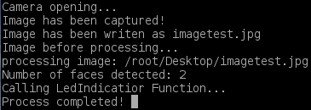
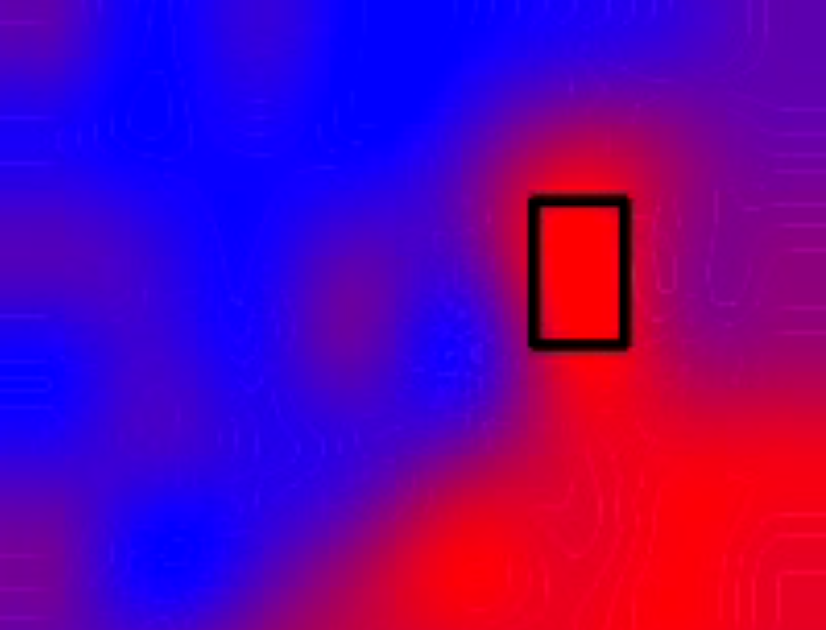
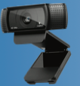
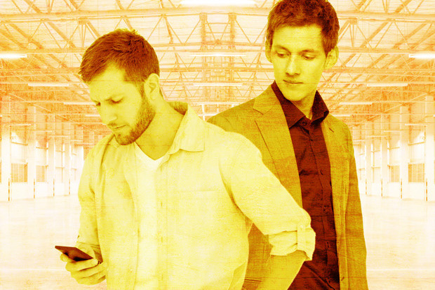
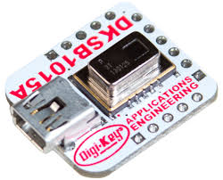
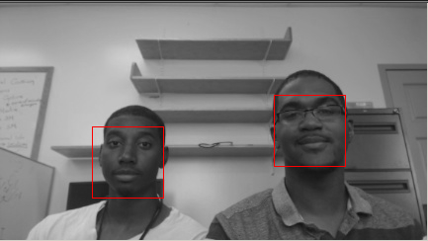
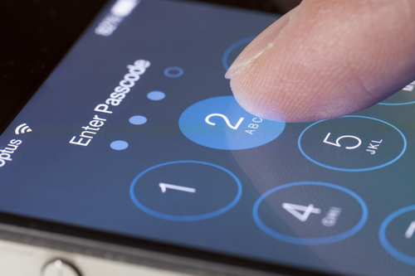
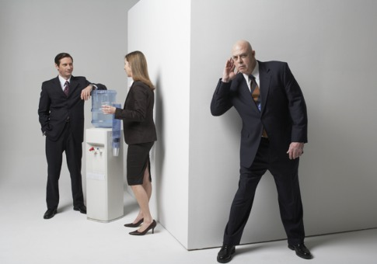
Counting Faces: Computer Vision and Privacy Application for Visually Impaired Persons
Joshua D. Bailey¹, Nigel R. Pugh² , Rakib Hasan³, Pat Shaffer³ and Apu Kapadia³
Mississippi Valley State University, Department Computer Science and Mathematics, jaybailey216@gmail.com
Elizabeth City State University, Department of Computer Science and Mathematics, nigel.pugh32@gmail.com
Indiana University, School of Informatics and Computing {rakhasan, patshaff, kapadia} @indiana.edu
People with Visual Impairment
Addressing Privacy Concern
BeagleBone Project Flow Chart
Code Output
All these privacy concerns share a common issue: Visually Impaired Persons are often ignorant of the number of people surrounding them.
IR Sensor
Detect Motion
How would you protect your privacy, if you could only see this clearly?
In the United States alone, over 8 million people are visually impaired
Does not need to be blind
May suffer from low-vision
May suffer from limited range of vision
Sample code output when two faces are detected
This project addresses this issue, and the goal is to build a system that is:
Low-power
Inexpensive
Supports open software tools and applications
Direct access to input/output pins which allow you to interface with electronic components, modules, and USB devices
Trigger HD Camera
Future Work
They have the same privacy concerns as you and I
Evaluation
Determine if someone in image captured is “known” or a stranger
Privacy Concerns
Hardware System
HD Camera Takes Image
Shoulder Surfing
Image Processing
Device Security
Acknowledgements
BeagleBone Black
Panasonic GridEYE IR Sensor
Logitech C920 Webcam
This material is based upon work supported by the National Science Foundation (NSF) under grants CNS-1408730 and IIS-1253549. Any opinions, findings, and conclusions or recommendations expressed in this material are those of the author(s) and do not necessarily reflect the views of the National Science Foundation
We developed a system that will inform a visually impaired person how many people are around them, utilizing a BeagleBone Black. Our system uses an infrared camera to detect the presence of an individual based on body temperature and an HD camera to capture an image. The image is then processed and the number of faces in the captured image is specified.
Eavesdropping
Determine Number of Faces

